Slide 1
QuizZenith
The lack of engaging online quiz platforms, characterized by outdated interfaces and limited functionalities, underscores the need for a MERN stack-based app. This aims to provide an innovative, user-friendly, and personalized quiz experience, addressing the current deficiencies in the market.

Slide 2
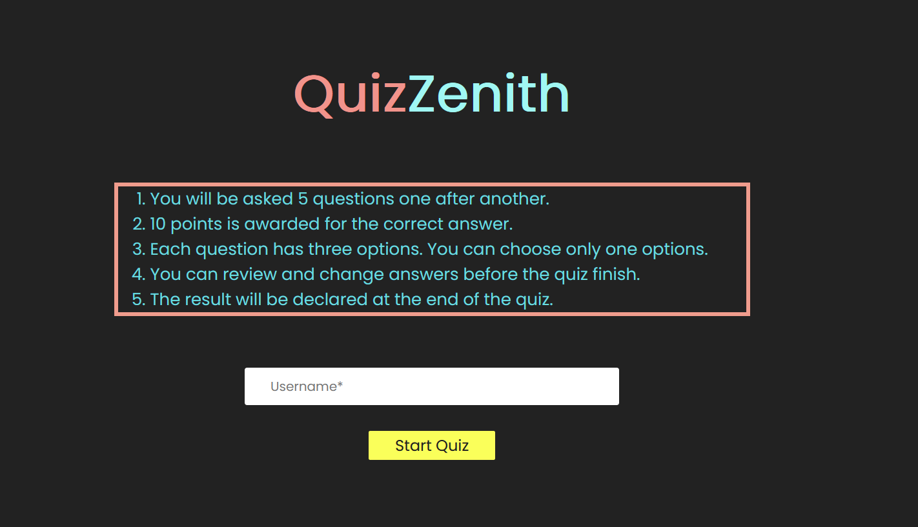
Introduction to QuizZenth React Application
Purpose
The Quiz React Application Is Designed To Help Students Prepare For Exams By Providing A Platform For Creating And Taking Quizzes. It Allows Users To Track Their Progress, And Review Their Answers.

Slide 3
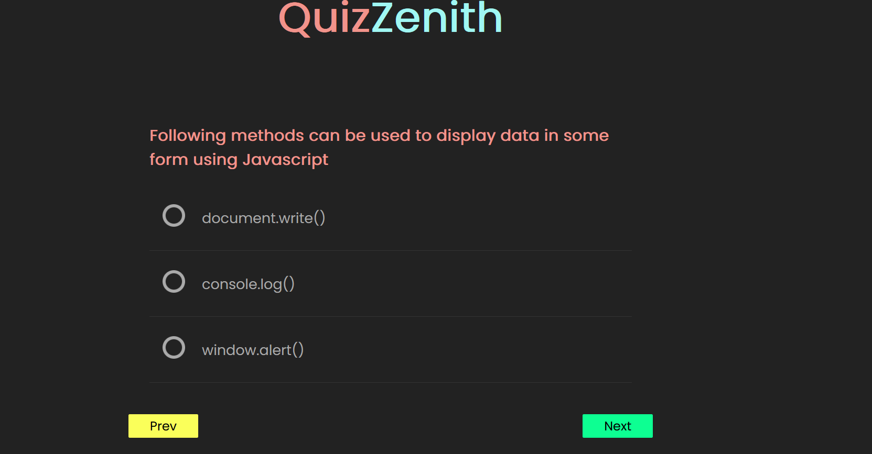
QuizZenith Features and Functionality
Quiz Interface:
Dynamic and interactive quiz interface built with React.js.
Users can navigate through questions using next
and previous buttons.
Each question is presented with multiple-choice options for users to select.

Slide 4
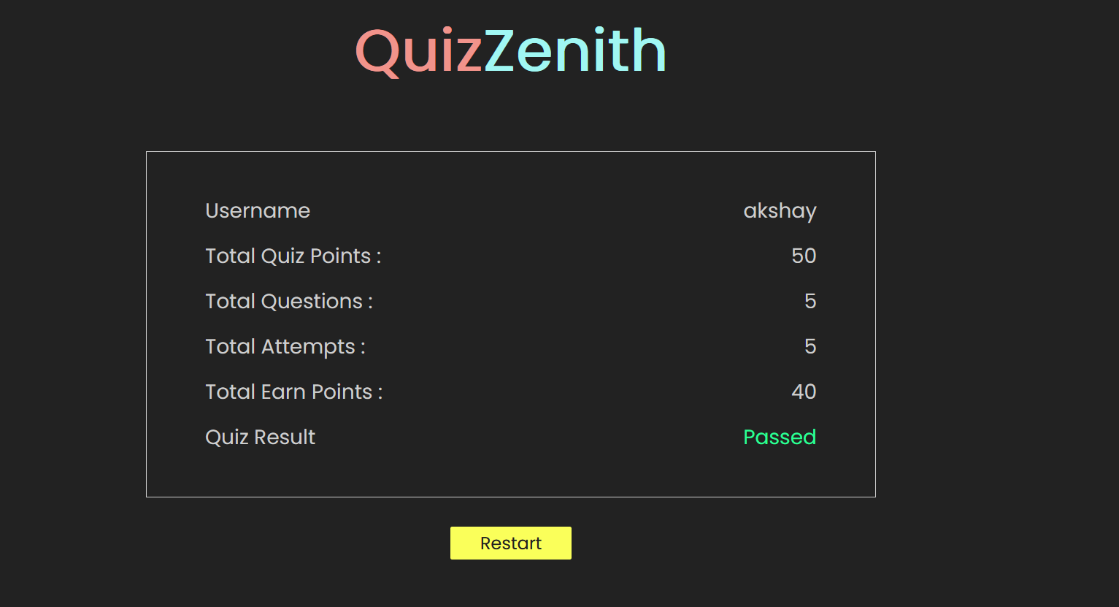
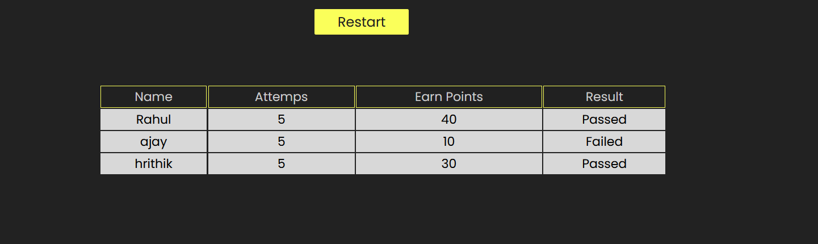
QuizZenith Features and Functionality
Quiz Taking
Users can select a quiz from the available options.
The application tracks and displays the user's progress and scores.
Users can review their answers and see the correct answers after completing the quiz.

Slide 5

Benefits of The Quiz Application
The QuizZenth Application provides a convenient and interactive platform for exam preparation, allowing students to test their knowledge and identify areas of improvement.
It offers a question types, including multiple-choice to simulate the actual exam experience.
The application tracks performance and provides detailed feedback, helping students track their progress and focus on weak areas.

Slide 6

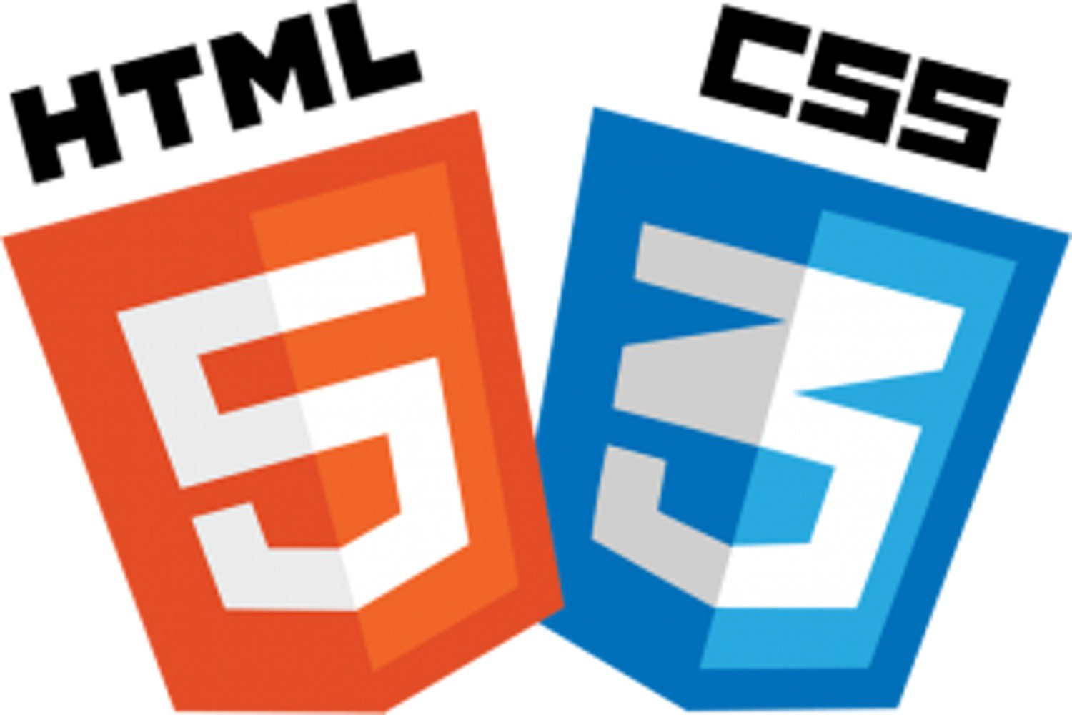
Languages Used in QuizZenith
Javascript(Js)
Javascript Is A Versatile Programming Language Used For Both Frontend And Backend Development.
In This Application, Javascript Is Primarily Used For Frontend Development With React.Js And For Backend Development With Node.Js.
HTML/CSS:
HTML (Hypertext Markup Language) is used for creating the structure of web pages.
CSS (Cascading Style Sheets) is used for styling the HTML elements, making the web pages visually appealing.
Both HTML and CSS are essential for building the user interface of the quiz application.

Slide 7



React.Js:
React.Js is A javascript library for building interactive user interfaces.
In this application, react.Js is used for the frontend to create the quiz interface, handle user input, and manage the application's state.
Node.js:
Node.js is a runtime environment that allows JavaScript to run on the server side.
In this application, Node.js is used to create the backend server, handle HTTP requests, and interact with the MongoDB database.
MongoDB:
MongoDB is a NoSQL database that uses a document-oriented data model.
IIn this application, MongoDB is used to store quiz questions, user data, and quiz results.

Slide 8

Future Objectives
Introduce new courses in various subjects such as science, history, literature, mathematics, etc.
Allow users to customize their quiz experience by selecting specific courses, difficulty levels, or question categories.
Enhance the performance tracking features to provide users with detailed insights into their quiz performance.
Enable users to share their quiz results and achievements on social media platforms.

Slide 9
Conclusion
Key Point
The Quiz Application is a powerful tool for exam preparation, providing a comprehensive and interactive learning experience.
The application is built using the MERN stack, leveraging the power of MongoDB, Express.js, React.js, and Node.js.
Users can give quizes, track their progress, and review their performance.
The application offers a of question types and supports multiple-choice and open-ended questions.
With its user-friendly interface and intuitive design, the Quiz Application is suitable for students of all levels.
Start preparing for your exams with the Quiz Application and boost your chances of success!

Slide 10
Thank You

